Slide 1
TEAM - SRKR
Mind Care AI
Team members
B KOUSHIK
S SUMANTH
P GOWTHAM
P YASHWANTH

Slide 2


Slide 3
THE GROWING CHALLENGE OF STUDENT MENTAL HEALTH
Current State of Student Mental Health :
Rising Incidence: Reports show increased rates of anxiety, depression, and stress among students.
Impact of COVID-19: The pandemic has exacerbated existing mental health issues, leading to increased isolation and uncertainty.
Contributing Factors :
Academic Pressure: High expectations and workload can lead to burnout.
Social Media: Constant comparison and cyberbullying contribute to anxiety and depression.
Life Transitions: Adjusting to new environments (e.g., college) can be overwhelming.
Financial Stress: Economic pressures affect students' mental well-being.
Signs and Symptoms :
Behavioral Changes: Withdrawal from social activities, changes in sleep or eating patterns.
Academic Decline: Drop in grades or disengagement in school.
Emotional Symptoms: Persistent sadness, irritability, or mood swings.

Slide 4
Features
The test includes scientifically validated questions designed to assess emotional, psychological, and social well-being. Based on users' responses, the system offers personalized insights and recommendations to enhance mental health awareness and promote self-care practices. This feature aims to help users gain a clearer understanding of their mental state and connect them with relevant resources for support.
After finishing the mental health test, users receive a personalized dashboard that visualizes their mental health status. This dashboard showcases key metrics like emotional well-being, stress levels, and overall mental health scores. Additionally, it offers tailored suggestions, resources, and actionable steps to enhance mental health based on the test results. This feature allows users to track their progress and make informed choices regarding their mental wellness.
Mental Health Test
Dashboard

Slide 5

Our website hosts a diverse collection of podcasts focused on mental health awareness. These episodes explore a variety of topics, including coping strategies, mindfulness techniques, and expert discussions on mental health issues. Listeners can gain valuable insights from professionals, hear personal stories, and receive practical advice aimed at enhancing their mental well-being. This resource provides an engaging way for users to stay informed and empowered throughout their mental health journey.
Our website features a thoughtfully curated selection of articles centered on mental health management. These articles deliver practical advice, research-based insights, and coping strategies to assist users in handling stress, anxiety, and other mental health challenges. Covering a variety of topics from self-care tips to therapy options, this resource is designed to educate and support users in nurturing their mental well-being.
Podcasts
Articles

Slide 6
Relaxation tools are vital for supporting student mental health. Mindfulness apps like Headspace and Calm provide guided meditations, while breathing exercises offer quick stress relief. Techniques such as guided imagery and progressive muscle relaxation help reduce anxiety and tension. Activities like yoga, journaling, and art therapy encourage self-expression, and spending time outdoors enhances mood. Music and sound therapy further promote relaxation, while peer support groups create a safe space for sharing experiences. Together, these tools foster resilience and well-being in students.
A community support forum for student mental health provides a safe space for students to connect and share experiences, reducing stigma and fostering peer support. It allows participants to exchange coping strategies and access resources, empowering them to manage their mental health effectively and build a resilient school community.
Relaxation Tools
Support Hub

Slide 7



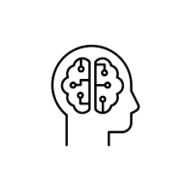

TechStacks
FrontEnd Tools :
For our frontend development, we utilized HTML, CSS, and JavaScript to create a responsive and engaging user interface. HTML served as the backbone, structuring the content and ensuring accessibility. We employed CSS to enhance the visual presentation, allowing for customizable styles, layouts, and animations that improved user experience. JavaScript added interactivity, enabling dynamic content updates and user-driven actions, such as form validation and real-time data manipulation. Together, these technologies formed a cohesive toolkit that ensured our application was both functional and visually appealing.
BackEnd Tools :
For our backend development, we chose Python with the Flask framework due to its simplicity and flexibility. Flask is a lightweight web framework that allows for quick setup and easy scaling of web applications. With its modular architecture, we could efficiently manage routing, request handling, and data processing. Python’s rich ecosystem of libraries facilitated seamless integration with databases and external APIs, enabling robust data manipulation and storage. Additionally, Flask’s built-in development server and debugging tools streamlined the development process, allowing us to focus on building a powerful and responsive backend to support our application’s frontend needs.

Slide 8
FeedBack
Pros :
Early Detection: AI can identify early signs of mental health issues through behavioral pattern analysis.
24/7 Availability: AI tools provide support anytime, ensuring help is accessible outside regular hours.
Data Insights: AI analyzes large datasets to uncover trends, aiding the development of effective mental health programs.
Cons :
Lack of Human Empathy: AI lacks emotional intelligence, which can limit its effectiveness in sensitive situations.
Data Privacy Concerns: Collecting personal data raises privacy issues, potentially leading to student mistrust.
Bias and Inaccuracy: AI systems can perpetuate biases, resulting in inaccurate assessments for certain student groups.

Slide 9

Future Works
Mobile App Development: Design mobile apps that combine various mental health resources, including meditation, journaling, and mood tracking, into a single platform.
Wearable Devices with AI Insights: Create smart wearables that track physiological indicators of stress (like heart rate variability) and use AI to provide real-time feedback and coping suggestions.
Digital Avatars for Counseling: Design AI-driven digital avatars that can conduct therapeutic sessions, providing students with a comfortable and anonymous way to engage in mental health support.

Slide 10
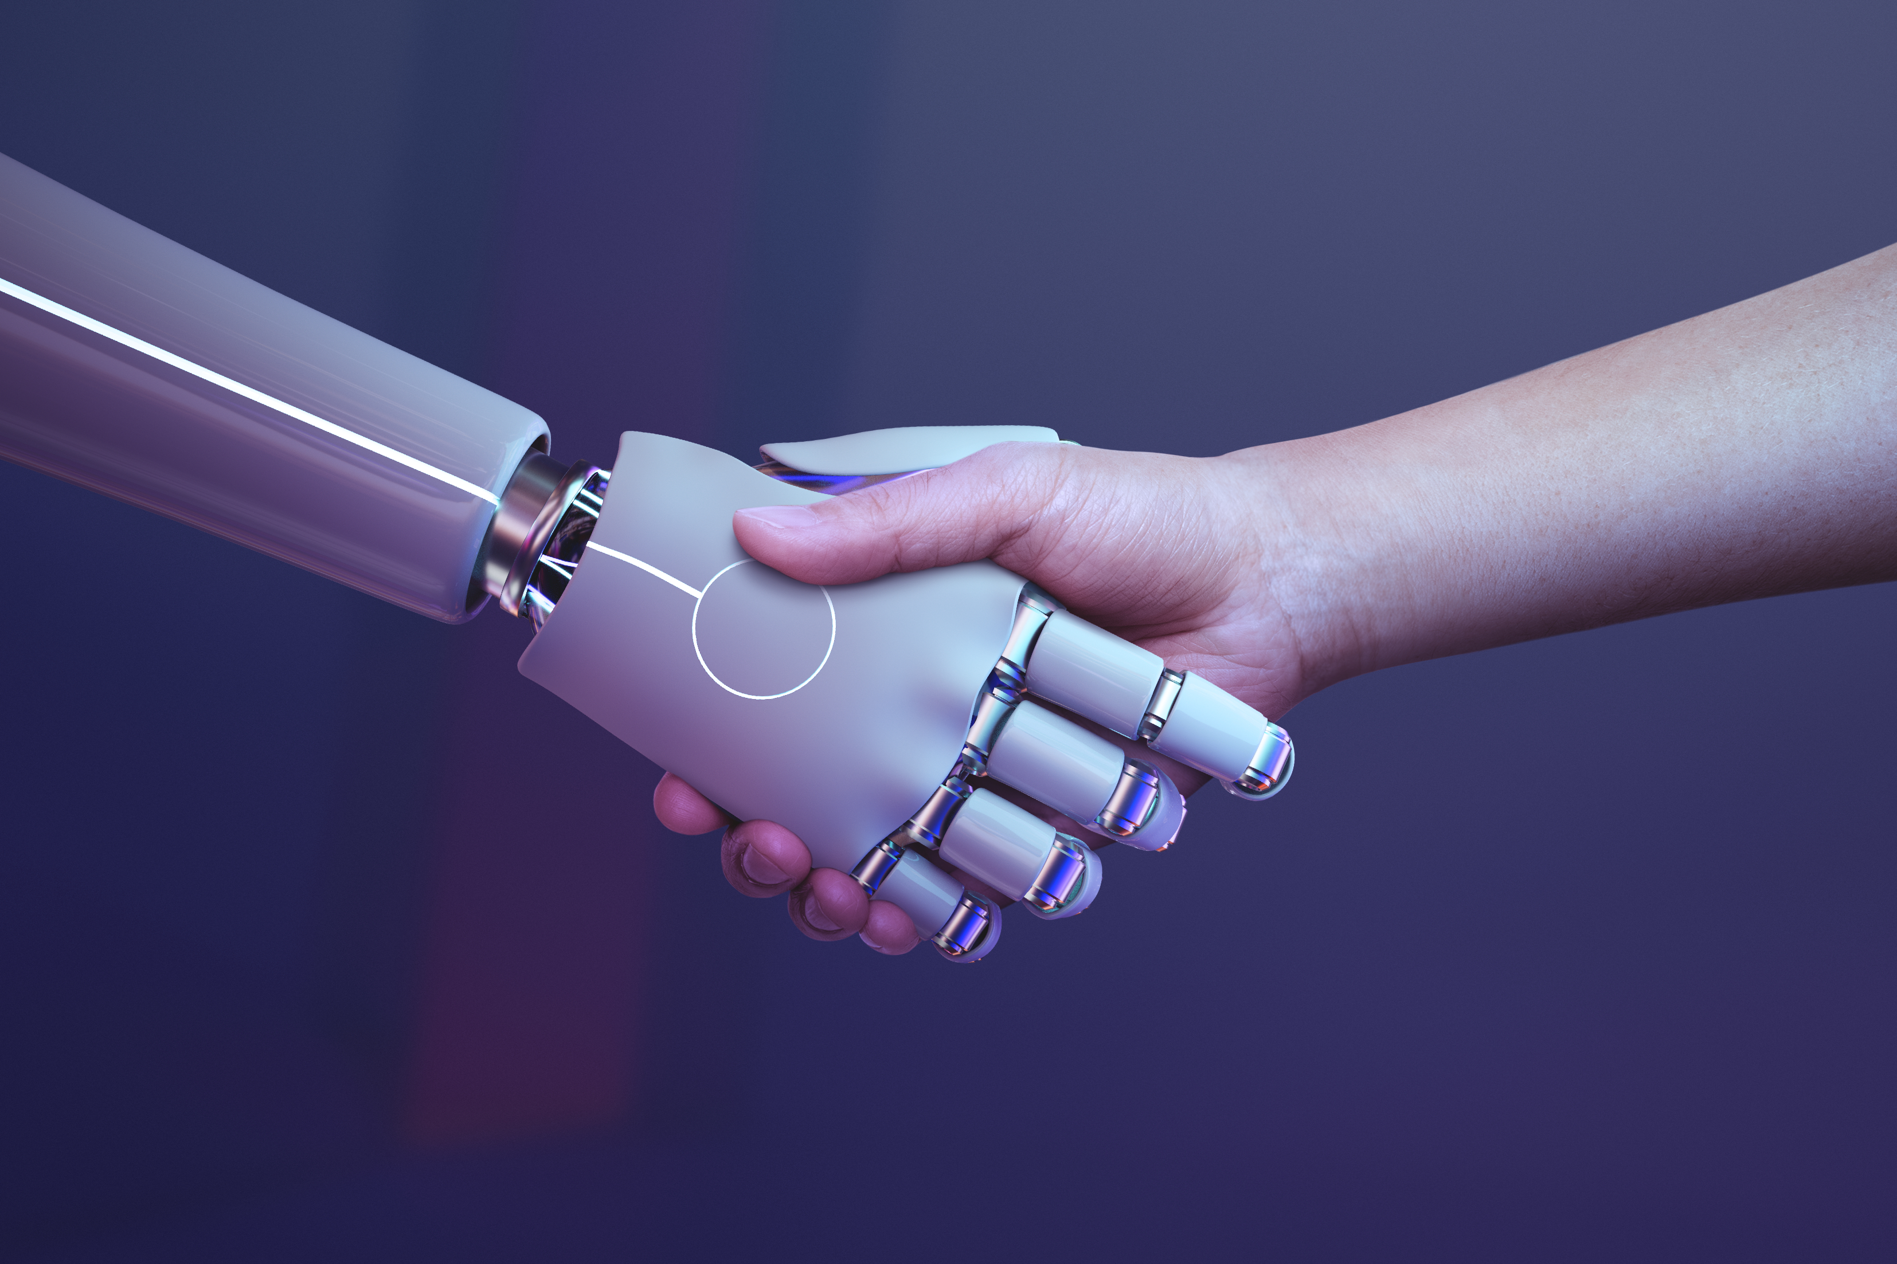
Thank You

